Slide 1
Object Oriented
Programming
&
Methodologies

Slide 2
OOM: Concepts & Implementation
Procedure Oriented Vs Object Oriented
Class & Objects in Java: Inheritance
  Adding Fields, Methods to a Class
  Instantiating an Object : Understanding the references
  Inheritance & Method Overloading
OOPS & Java Implementation
  Polymorphism & Abstraction : Java API
Objects Oriented Design & UML
GUI in Java & Event Handling
  Applets & Sandbox Security
Software Project Issues: DBMS & OOM
  Connectivity Issues

Slide 3
The 03 Principles of OOM
Inheritance , Encapsulation and Abstraction are considered basic principles of OOM it can produce many useful programming constructs that supports the development of far more robust & scalable software .
A well designed hierarchy of classes is the basis for re using the code in which lot of time and expertise was invested in developing & testing.
car
Super class
manual
auto-
matic
Subclasses
draw()
draw()

Slide 4
Simple Class Example:OOM design
Let us continue with the simple example of preparing software for Employee Pay roll calculation.
The design of the Employee class might seem fine initially.
The Employee class has a field named salary, which implies that an employee has a salary; however, hourly employees have an hourly rate, which is quite different from a salary.
  Instant idea: A tempting fix for this situation is to add a Boolean field to the Employee class named isSalary that is true for salary employees and false for hourly employees.
The salary field could be used to represent an annual salary when isSalary is true or an hourly rate when isSalary is false.

Slide 5
Employee Class with 02 methods and 05 Fields
public class Employee
{
public String name;
public String address;
public int number;
public int SSN;
public double salary;
public void mailCheck()
{
System.out.println(“Mailing check to “ + name
+ “\n” + address);
}
public double computePay()
{
return salary/52;
}
}

Slide 6
OOPS….
For example, The isSalary field could also be used within the computePay() method to determine which arithmetic to use because computing pay for salaried employees is different than for hourly employees.
public float computePay()
{
if(isSalary)
{
//Perform arithmetic for salaried employee
}
else
{
//Perform arithmetic for hourly employee
}
}

Slide 7
OOM design
Adding a field such as isSalary and trying to use one class to represent two different types of objects is not a good OOP design.
We could make it work, but we are not taking advantage of the benefits of OOPS.
If we use a field to determine the type of an object, your end result is a class that looks object-oriented but is really procedural.
For example, an Employee object will need to check this added Boolean field just to know what type of object it is, causing the design of the program to not be focused on objects.

Slide 8
OOM Design
A bigger problem arises when something needs to be changed. What happens to the isSalary field when a new type of employee needs to be added?
Suppose that the company starts hiring contractors who are paid by the day. The Boolean no longer works because it can’t be used to distinguish between three types.
You could change the field to an int, name it employeeType, and use an enumeration like 0 for salary, 1 for hourly, and 2 for contractor.
Again, you could make this work, but you have to make serious modifications to the Employee class. The computePay() method will have to entirely rewritten:

Slide 9
Revised computePay method
public float computePay()
{
switch(employeeType)
{
case 0:
//Perform arithmetic for salaried employee
break;
case 1:
//Perform arithmetic for hourly employee
break;
case 2:
//Perform arithmetic for contractor employee
break;
//and so on if necessary
}
}

Slide 10
Example:OOM design
And the computePay() method will keep getting longer and longer as different types of employees arise.
Any time you find yourself writing classes that do not know what type they are, you probably should rethink your design.
We need to realize that although employees are objects in our problem domain, there are actually two different types of employee objects: salaried employees and hourly employees
Therefore, we should write two classes: Salary and Hourly.

Slide 11
Two Classes
public class Hourly
{
public String name;
public String address;
public int SSN;
public int number;
public float hourlyRate;
public float hoursWorked
public void mailCheck()
{
System.out.println(“Mailing a check to “ + name + “ “ + address);
}
public float computePay()
{ return (float) hoursWorked * hourlyRate;
}
}
public class Salary
{
public String name;
public String address;
public int SSN;
public int number;
public float salary;
public void mailCheck()
{
System.out.println(“Mailing a check to “ + name
+ “ “ + address);
}
public float computePay()
{
return (float) salary/52.0;
}
}

Slide 12
Example: OOM design
As you can see, the Salary and Hourly classes are repeating code. Salary and hourly employees are still employees, and there is a lot of information in common between the two.
Although Salary and Hourly employees are different types, they are not entirely different. Which is seen by the repetition of fields and methods in these two classes.
The Salary and Hourly classes demonstrate the need for inheritance.
Using inheritance will improve this design considerably, not only to avoid repeating code, but also to create a program design that allows for better maintenance and code changes later.
Therefore, writing two separate classes for the two different types of employees is not yet a satisfactory solution.
Appropriate Use of Inheritance is definitely an issue….

Slide 13
OO Design…
A better design for the Salary and Hourly classes is to take their common elements and put them in a parent class, leaving the unique elements in the child classes.
  Ex. the mailCheck() method could appear in the Employee parent class, and the computePay() method could appear in each of the child classes.
The assumption is that the process of mailing a check is the same for all employees, but computing their pay is directly affected by how they are paid.
Employees do not share a common computePay() method. By placing computePay() in each child class, the method will be written twice.
This is not repeating code, though, because computePay() in Salary is quite different than computePay() in Hourly.

Slide 14
Example: OOM design
This benefit is difficult to achieve with procedural programming and also with poorly designed OOP applications.
For appropriate use and also to avoid these situations, constantly test your OOP design against these simple rules:
An object “has” an attribute, and an object “does” a behavior.
In our employee example, if it is not true that an employee “has” a salary, an Employee class should not have a salary field, and we should redesign our program.
None of the existing code needs to be touched.
With OOPS Characteristics - inheritance, all of these issues are avoided.
The common features of employees appear in a parent class. Each different type of employee is represented by a child class.
When a new type of employee such as a contractor comes along, a new child class is written that extends the parent class.
Using inheritance will improve this design considerably, not only to avoid repeating code, but also to create a program design that allows for better maintenance and code changes later but it should be used only when it is really existing !!.

Slide 15
Inheritance in Class
&
Object instantiation

Slide 16
Inheritance in Java
A Class inheriting Parent Class gets both data and methods (or Functions) of Parent Class and can add new Data3 for Child Class .
Data1
Data2
ParentClass
Method1
But When we want to instantiate objects from these two classes then
How will we instantiate the two objects?
what are the different possibilities??
Data3
Method1
ChildClass

Slide 17
Inheritance in Java
Inheritance relation between Employee Class (Parent Class) and Salary Class (Child Class) can be done by using the extends relationship:
Also similarly Hourly class should also use extend another class A if and only if
Employee
Salary
Hourly

Slide 18
Suppose there is simple Class Inheritance method "Employee“ with Child Classes Hourly and Salary ,
How will be objects instantiated ??

Slide 19
Implementing Inheritance
A class uses the extends keyword to inherit from another class.
It appears after the class name when declaring the class and is followed by the name of the class being extended.
For Ex, the Salary class is a child of the Employee class:
public class Salary extends Employee
Similarly, the Hourly class can extend Employee with the statement:
public class Hourly extends Employee
The following Employee class will be used as the parent of Salary and Hourly. No special code to denote that Employee is a parent class.
public class Employee
{ public String name;
public String address;
public int SSN;
public int number;
public void mailCheck()
{
System.out.println(“Mailing a check to “ + name
+ “ “ + address);
} }

Slide 20
The following Salary class uses the extends keyword to denote Salary is a child class of Employee.
public class Salary extends Employee
{
public float salary; //Annual salary
public float computePay()
{
System.out.println(“Computing salary pay for “ + name);
return salary/52;
}
}

Slide 21
Similarly, the following Hourly class extends the Employee class using the extends keyword.
public class Hourly extends Employee
{
public float hourlyRate; //Pay rate
public float hoursWorked; //Weekly hours worked
public float computePay()
{
System.out.println(“Computing hourly pay for “ + name);
float pay = 0.0F;
if(hoursWorked <= 40)
{
pay = hourlyRate * hoursWorked;
}
else //Need to compute overtime
{
pay = (hourlyRate * 40) +
(hourlyRate * (hoursWorked - 40) * 1.5F);
}
return pay;
}}

Slide 22
We have defined the Employee, Salary, and Hourly classes,
Let’s look at a program that instantiates and uses these classes.
The following Inherit-
Demo program creates an Employee, Salary, and Hourly object.
Study the program carefully and try to determine its output

Slide 23
public class InheritDemo
{public static void main(String [] args)
{System.out.println(“Instantiating an Employee”);
Employee e = new Employee();
e.name = “Robert Smith”;
e.address = “111 Java Street”;
e.SSN = 999001111;
e.number = 1;
System.out.println(“Instantiating a Salary”);
Salary s = new Salary();
s.name = “Jane Smith”;
s.address = “222 Oak Drive”;
s.SSN = 111009999;
s.number = 2;
s.salary = 100000.00F;
System.out.println(“Instantiating an Hourly”);
Hourly h = new Hourly();
h.name = “George Washington”;
h.address = “333 Espresso Lane”;
h.SSN = 111990000;
h.number = 3;
h.hourlyRate = 10.00F;
h.hoursWorked = 50;
System.out.println(“Payingemployees”);
//e.computePay(); //Does not compile!
System.out.println(s.number + “ “ + s.computePay());
System.out.println(h.number + “ “ + h.computePay());
System.out.println(“Mailing checks”);
e.mailCheck();
s.mailCheck();
h.mailCheck();
}}

Slide 24
The InheritDemo program starts by instantiating each of the three employee types and initializing their fields.
Up until the “Paying employees” statement, the only output is:
Instantiating an Employee
Instantiating a Salary
Instantiating an Hourly

Slide 25
Invoking the computePay() methods on the Salary and Hourly objects generates the following output:
Paying employees
Computing salary pay for Jane Smith
2 1923.0769
Computing hourly pay for George Washington
3 550.0
Notice that the Employee object referenced by e in the InheritDemo program cannot invoke the computePay() method because the object does not have a computePay() method.
In fact, there is no place to put information about how or what Robert Smith is paid.
It is safe to say that no employee at the company will want to be of type Employee.

Slide 26
The mailCheck() method is available to all three objects in the InheritDemo program.
Invoking them causes the following output:
Mailing checks
Mailing a check to Robert Smith 111 Java Street
Mailing a check to Jane Smith 222 Oak Drive
Mailing a check to George Washington 333 Espresso Lane

Slide 27
Object Instantiation in Inheritance
Consider following :
1) Can Class A instantiates the object of type B ?
2) Can Class B instantiates the object of type A ? Or of type C ??
3) Can Class C instantiates the object of type A or type B or type C?
Above possibilities give many Interesting programming constructs
A
B
C

Slide 28
Object Class and
Methods

Slide 29
Methods in Java
  In Java there two types of Methods:
  Built-in: Build-in methods are part of the compiler package, such as System.out.println( ) and System.exit(0) and method toString() method in Object class.
  User-defined: User-defined methods are created by you, the programmer.
    These methods take-on names that we assign to them and perform tasks that we write as code.
  Can we use toString() method of OBJECT class and change it’s behaviour ??

Slide 30
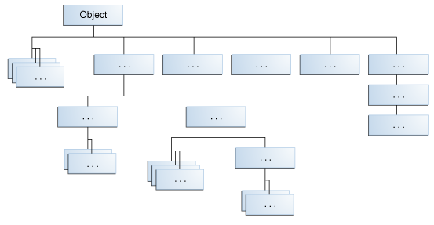
The Object Class
The Java language API includes a special class named Object that is the root class of the entire Java hierarchy.
The Object class, found in the java.lang package, is the parent of every Java class, either directly (meaning the class is an immediate child of Object) or indirectly (meaning Object is an ancestor further up the inheritance tree).

Slide 31
The java.lang.Object Class
The Java language API includes a special class named Object that is the root class of the entire Java hierarchy.
The Object class, found in the java.lang package, is the parent of every Java class, either directly (meaning the class is an immediate child of Object) or indirectly (meaning Object is an ancestor further up the inheritance tree).
For example, consider Employee class that does not declare a parent class.
public class Employee
{
//Class definition
}
Because this Employee does not explicitly extend another class, it implicitly extends Object. In fact, we could have added the extends keyword as follows:
public class Employee extends Object
{
//Class definition
}

Slide 32
Object
Suppose that a Salary class is written that extends Employee:
public class Salary extends Employee
{
//Class definition
}
Because a Java class can only have one parent class, Salary does not extend Object directly. Because Employee extends Object, however, the Salary class is an indirect child of the Object class.
Note that the compiler does not add “extends Object” to a child class that already extends another class. (why ?)

Slide 33
The Methods of the Object Class
Object is a parent of every class, so the methods in the Object class are inherited by every Java object.
Thus, the methods in the Object class can be invoked on any Java object, no matter what class type the object is.
The following list contains the signatures of the methods in the Object class :
public final Class getClass().
public int hashcode()
public boolean equals(Object x)
protected Object clone() throws CloneNotSupportedException.
public String toString().
protected void finalize() throws Throwable
public final void wait() throws InterruptedException
public final void notify().

Slide 34
Constructor
A Constructor is a special method in a class that is invoked when the object gets instantiated.
The purpose of a constructor is to allow the fields of the object to be initialized when the object is instantiated.

Slide 35
The Methods of the Object Class
Object is a parent of every class, so the methods in the Object class are inherited by every Java object.
Thus, the methods in the Object class can be invoked on any Java object, no matter what class type the object is.
The following list contains the signatures of the methods in the Object class :
public final Class getClass().
public int hashcode()
public boolean equals(Object x)
protected Object clone() throws CloneNotSupportedException.
public String toString().
protected void finalize() throws Throwable
public final void wait() throws InterruptedException
public final void notify().

Slide 36
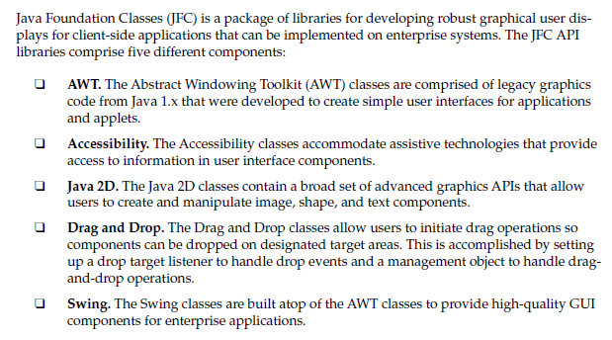
Java Foundation Classes

Slide 37
Core/Foundation Packages in Java 6
 | Name of Package | Description
 | java.lang | — basic language functionality and fundamental types
 | java.util | — collection data structure classes
 | java.io | — file operations
 | java.math | — multiprecision arithmetics
 | java.nio | — the New I/O framework for Java
 | java.net | — networking operations, sockets, DNS lookups, .
 | java.security | — key generation, encryption and decryption
 | java.sql | — Java Database Connectivity (JDBC) to access databases
 | java.awt | — basic hierarchy of packages for native GUI components
 | javax.swing | — hierarchy of packages for platform-independent rich GUI components
 | java.applet | — classes for creating and implementing applets

Slide 38
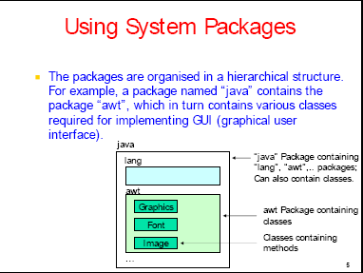

Slide 39


